Slide 1
Stakeholder consultation: Environment Management Framework
Government of Karnataka
11th Dec 2015
Organized by
Decentralization Analysis Cell
Department of RDPR, Government of Karnataka

Slide 2
Overview of the presentation
About the Project
Project Activities
Environmental Implications
Environment Management Framework
Components – Legal requirements, impacts and mitigation measures
Approach of EMF, Implementation
Pilots in Hotspot areas

Slide 3
About Proposed Project
Project Development Objective: The Project Development Objective is to enhance the ability of Gram Panchayats to manage resources and deliver services prioritized in their development plans in the least developed areas of Karnataka”
Project Components:
Component A: Block grants to Gram Panchayats
Component B: Institutional Development
Component C: Project Management Support
Proposed project by including 1355 ‘more backward’ in addition to the ‘most backward GPs’ (with 1431 GPs). making the total coverage to 2786 GPs

Slide 4
Project Activities – Block Grants
Most common works include:
CC Road construction: 44.5%
Buildings – school buildings, bus stops, anganwadis, community halls, GP buildings etc: 33%
Drainage works, Public toilets: 18%
Drinking water supply: 4.5%

Slide 5
Project Activities and Average Costs

Slide 6
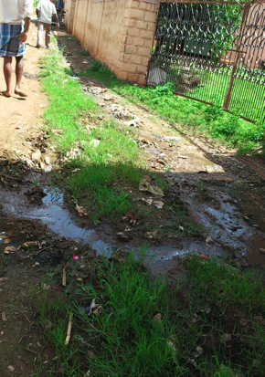
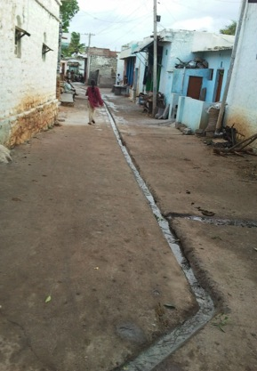
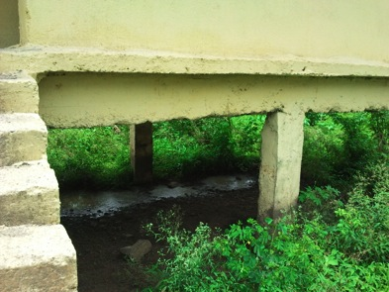
Environmental Implications
Positive impacts through improved sanitation, positive health impact due to safe drinking water supply
Negative impacts possible due to site clearance for infrastructure works, extraction of local resources, waste disposal, improper use and maintenance of facilities

Slide 7
Environment Management Framework (EMF)
Environment Assessment and Environment Management Framework is required as per the requirement of World Bank Safeguard Policy OP/BP 4.01
OP/BP 4.04 Natural Habitats
OP/BP 4.36 Forests
Objective of EMF : To ensure environmental sustainability of the activities undertaken by Gram Panchayats

Slide 8
EMF comprises of..
Rules and regulations governing
Site selection, site clearance: forest areas, ecologically sensitive areas, Coastal areas, removing the vegetation etc.
Raw material extraction: illegal mining of sand, rocks, water extraction etc.
Pollution during construction and waste disposal: noise and dust pollution, disposal of rubble etc.
A list of Do’s and Don’ts is prepared for ensuring compliance
Potential Impacts and mitigation measures for construction activities

Slide 9
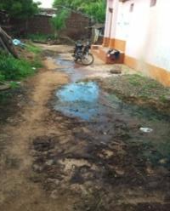
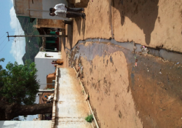
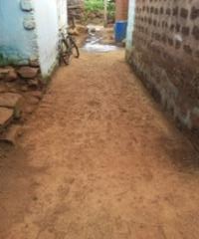
Potential Impacts and Mitigation Measures
Road construction
Potential Impacts | Mitigation Measures
Improper designs and maintenance of drains leading to overflow of sullage | Proper designs and maintenance
Complete paving of roads | Leaving spaces in between for natural infiltration.

Slide 10
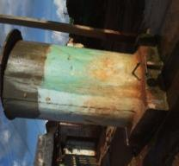
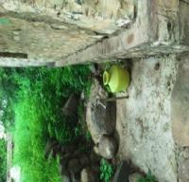
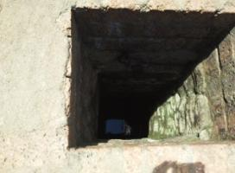
Contd..
Drinking water
Potential Impacts | Mitigation Measures
Possibility of contamination of the source | Water quality test prior to commissioning of the source and setting up mechanism for regular periodic monitoring
Location of water source near toilets and pipe alignment | Water source and pipeline alignment away from contamination sources like toilets, drains etc.
Safety concerns with abandoned bore holes, open wells | Covering the abandoned bore wells, grills or protective walls around open wells
Water wastage due to improper use and maintenance | Provision for drains or soak pit near source and system for regular check up

Slide 11
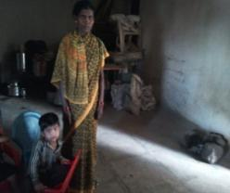
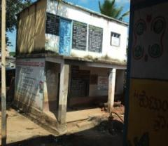
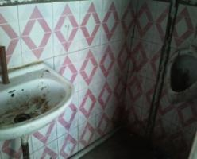
Contd..
Buildings: Schools, Anganwadi Centres, GP buildings, Community halls etc.
Potential Impacts | Mitigation Measures
Lack of facilities like toilets, lack of system for solid and liquid waste management leads to unhygienic conditions | Provision of all facilities and emphasis on special needs like child friendly toilets in anganwadis
Kitchens part of class room in anganwadis causes pollution and is prone to fire accidents | Anganwadis should have separate kitchen with chimney
Lack of safety measures like grills and parapet walls | Provision of safety measures for all buildings

Slide 12
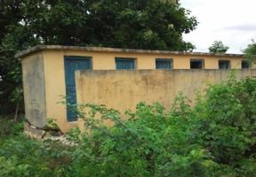
Contd..
Public Toilets
Potential Impacts | Mitigation Measures
Absence of septic tank or leach pit | Septic tanks or leach pits to be made compulsory
Lack of water facility inside the toilets discourages the use and affects cleanliness | Running water inside the toilet, hand wash facility out side, ecosan toilets in areas with water scarcity
Poor ventilation affects cleanliness and discourages use | Design should consider proper ventilation
Improper use and maintenance leads to discontinuation and is hazardous to the environment | Awareness building among the users for sustenance of the facilities

Slide 13
Learning from previous project
Learnings from the previous project:
System of OK cards: Not followed for all works (present in 37%)
Identifying the relevant issues or mitigation measures: Not done in all OK cards
Trainings to engineers on technical aspects was not envisaged
Strategy for proposed project:
Simplifying the procedures
Capacity enhancement of Engineering Staff
Strong monitoring system

Slide 14
Approach of EMF
Integrating environmental sustainability dimension into the GP perspective plans and annual action plans
Integrating required environmental guidelines into all construction activities
Integrating aspects of environment management into the capacity building programmes

Slide 15
Environment Review of Annual Action Plan
Work Stage | Stage of environment review and monitoring | Officials Involved
Annual Action Plan (AAP) Preparation | Environmental review of Annual Action Plan using the OK cards . | Junior Engineer, Assistant Engineer General Body
Technical designs and cost estimates | Integration of mitigation measures in to designs and budget | Section Officer, Junior Engineer, Assistant Engineer
Environment Review of technical designs | AAPs without ER or integration of measures and budget are sent back for action | Environment Engineer
Technical approval for the designs | Review of design of mitigation measures | Assistant Executive Engineer
Administrative approval, tenders and procurement | Administrative approval of environment review, inclusion of obligations into contracts | Panchayat Development Officer
Supervision of execution of works | Supervision of inclusion of mitigation measures | Assistant Executive Engineer Junior Engineer, Assistant Engineer
Verifying environmental compliance of works |  | Environment Engineer
Measurement, payment and completion report | Report on environmental compliance | Panchayat Development Officer, Adhyaksha

Slide 16
Capacity Building Plan
Technical trainings for Engineer staff on integration of environmental aspects into designs
Technical Support Agency
Main trainings (1 week) followed by yearly refresher training
Training on Environment Management for Engineers
ANSSIRD, Environment Specialist
Main trainings (2 days) followed by yearly refresher training
Training on Environment management for the PRIs
ANSSIRD
Main training and yearly refresher trainings
Training on Environment management for the PRIs
IEC strategy

Slide 17
Monitoring Plan
Internal Monitoring
Monitoring all GP works during construction: Junior Engineer, Assistant Engineer, Executive Engineer
Verification of all GO works post construction: Environment Engineer
Monitoring of a sample 5% works during and post construction: Environment Specialist
External Monitoring:
Before midterm and before closure of the project

Slide 18
Monitoring Indicators
Activity Indicators | Compliance status | Rating
Percentage of roads with well-maintained drains | 80-100% 60-80% 40-60% Below 40% | Satisfactory Moderately satisfactory Less satisfactory Not satisfactory
Percentage of drinking supply activities with potability confirmed through quality test in last 6 months
Percentage of anganwadis having separate kitchen with chimney and toilet
Percentage of buildings with functional toilets
Percentage of functional public toilets with leach pits or septic tanks and running water facilities

Slide 19
Pilots in Hotspot Areas

Slide 20
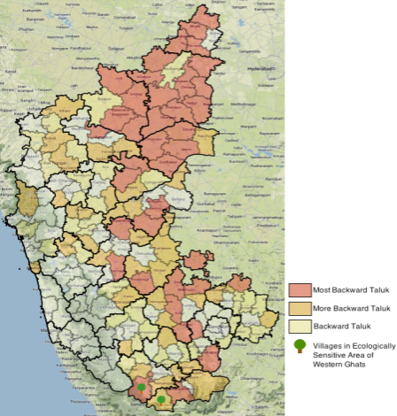
Forests, Biodiversity
Forest area:
National Parks, Wild Life Sanctuaries and Tiger Reserves in 13 Project Blocks
Western Ghats:
UNESCO World Heritage site. 7 Project villages are part of Ecologically Sensitive Areas of WGs

Slide 21
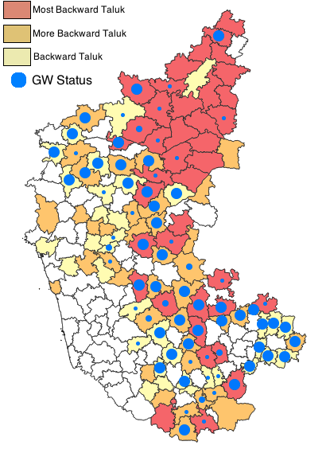
Water Scarcity
Drought prone areas:
Two thirds of the state experiences drought.
70% of the Taluks in the State and 70 Project Taluks are drought affected.
Groundwater status:
Stage of groundwater development is 64% with 22 project taluks over exploited
5 project taluks in 3 districts are notified for regulation of ground water development.
Ground water quality issues exist in 9 project taluks

Slide 22
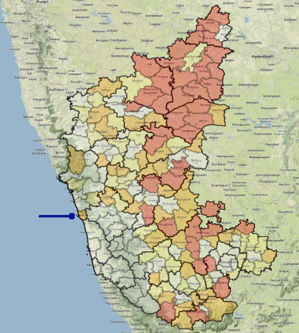
Coastal Area
Coastal Block in Uttara Kannada: Bhatkal
Thickly populated, intensely cultivated
Threat of cyclones

Slide 23
Additional Support in Hotspot Areas
Hotspot areas: pilots with handholding support for 2 years
Pilot in W. Ghats GPs – 7 GPs
Pilot in coastal GPs - GPs
Pilot in GPs in over-exploited groundwater areas - 5 GPs
Pilot in GPs in poor water quality areas – 5 GPs
Pilot in GPs in drought prone areas – 5 GPs
Support of NGOs or Government Institutions in
Capacity Building the GPs
Support in integrating environment guidelines into GP works
Monitoring the use and maintenance

Slide 24
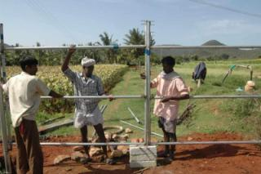
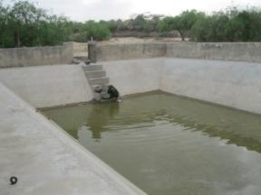
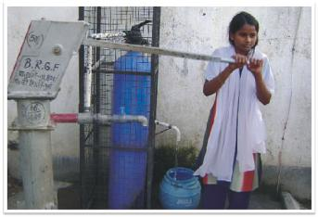
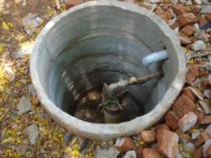
Pilots
Fencing to avoid wildlife conflict
Rainwater harvesting in drought areas
Groundwater recharge
Fluoride free water supply
Pictures in this slide are sourced from internet for illustration purpose

Slide 25
Institutional Arrangements
Internal:
Environment Specialist at State level: overall coordination of EMF implementation
PRI technical staff - Junior Engineers, Executive Engineers, Section Engineers: Environment review of Annual Action Plans (AAPs) and integration of mitigation measures into designs
Environment Engineers: Environment Review of technical designs, verification of environmental compliance
Junior Engineers, Executive Engineers: Supervision of works
ANSSIRD: Capacity building
External Support:
Technical Agency for training technical staff and developing guidance manual
NGOs or Government Institutions for pilots in Hotspot areas
External agencies for external audits
Budget: 1.85 crores
Duration: 6 years

Slide 26
Thank you

